Slide 1
Ch. 8: Cyberphysical Systems (CPSs)
Prof. E.B.Fernandez

Slide 2
Pentagon Reveals Cyber Breach of Travel Records https://www.securityweek.com/pentagon-reveals-cyber-breach-travel-records Oct.2, 2018
The Pentagon on Friday said there has been a cyber breach of Defense Department travel records that compromised the personal information and credit card data of U.S. military and civilian personnel.
According to a U.S. official, the breach could have affected as many as 30,000 workers, but that number may grow as the investigation continues. The breach could have happened some months ago but was only recently discovered.
The official said that no classified information was compromised.
According to a Pentagon statement, a department cyber team informed leaders about the breach on Oct. 4.

Slide 3
Cyber-Physical Systems (CPSs)
A cyberphysical system (CPS) integrates computing and communication capabilities with the monitoring and control of entities in the physical world
Normally distributed, real-time, usually include embedded devices, sensors, actuators, and wireless links
Many system components are remotely deployed, have unique constraints, and may be physically inaccessible for maintenance, and/or physically accessible for attack
Examples include transportation systems, smart power grids, patient monitoring, smart buildings, flexible manufacturing systems, and many others
CPSs require a high level of adaptability because of continuously-changing conditions and need situation awareness and modifiability
They may include legacy systems and they increasingly include humans in the loop.
Typically, they use combinations of Commercial Off The Self (COTS) components and real-time operating systems, as well as products from different vendors and using different protocols
Many CPS also need to follow government or state regulations

Slide 4
Other Characteristics of CPS
Cyber – physical coupling driven by new demands and applications
Cyber capability in every physical component.
Large scale wired and wireless networking.
Networked at multiple and extreme scales.
Systems of systems
New spatial-temporal constraints.
Complex at multiple temporal and spatial scales.
Dynamically reorganizing/reconfiguring.
Unconventional computational and physical substrates (Bio? Nano?).
Novel interactions between communications, computing and control
High degrees of automation, control loops must close at all scales.
Large numbers of non-technical savvy users in the control loop.
Ubiquity drives unprecedented security and privacy needs
Operation must be dependable, certified in some cases

Slide 5
Cyber-physical systems (CPSs) III
Often, CPSs are safety-critical, because their failure could endanger lives or cause large economic losses.
Safety is the freedom from unacceptable risks, including threats to human lives, the environment, or to costly facilities.
Wireless networks and inexpensive sensors have made them much more important
Humans in the system means that privacy can be important
Use of AI brings new capabilities but also new threats
UML can be used to represent software but also physical things or we can use SysML

Slide 6
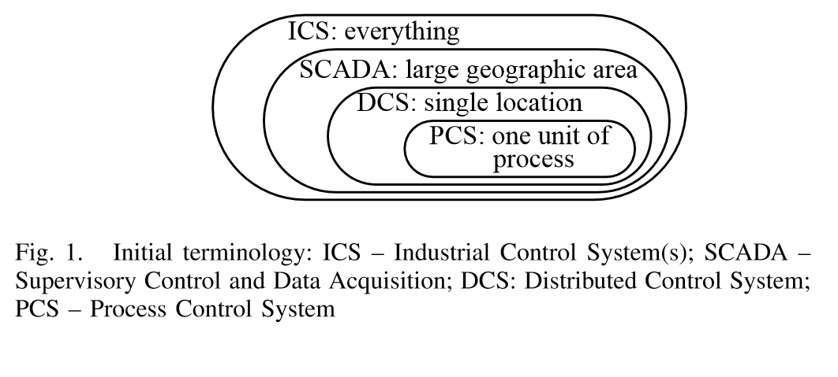

Slide 7
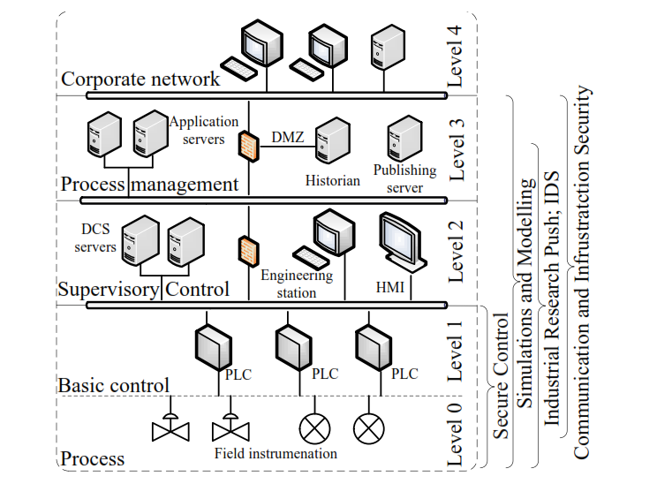
CPS architecture

Slide 8
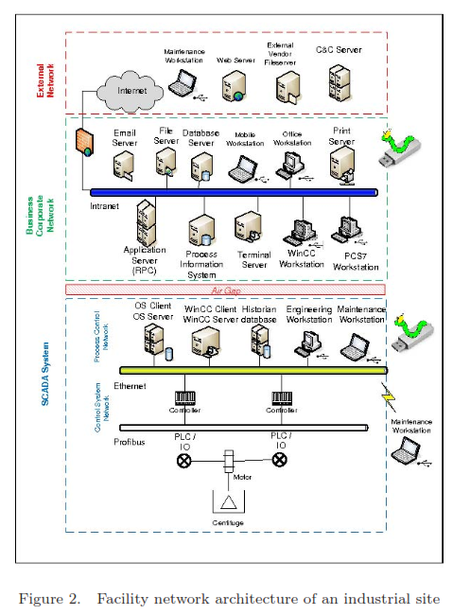

Slide 9
Infrastructure systems are made of CPSs
Infrastructure systems are needed to sustain a civilized life
They include transportation, finance and banking, government, chemical, energy, oil and gas production and distribution, health services, information management, water (drinking and irrigation), emergency services (fire, police), garbage collection, and other areas
All of these infrastructure functions are controlled by CPSs which are complex and becoming increasingly interdependent; each system typically depends on one or two other systems
Some are even mutually dependent, e.g. electric power generation may require oil, and oil production may require electricity.
Most of them are organized as control systems (SCADA: Supervisory and Data Acquisition )

Slide 10
Supervisory Control and Data Acquisition (SCADA) systems structure

Slide 11
SCADA units
A control loop. This includes sensors, controllers, actuators, and communication links, that operate on a controlled process. Sensors collect information from the controlled process and send it to the controller which adjusts parameters based on these values and their set points.
A human-machine interface (HMI). Used by engineers and operators to define set points, control algorithms, and adjust parameters. The HMI also displays status information and historical information.
Remote diagnostic and maintenance functions. Used to identify and recover from failures or attacks.
Databases. Contain control information, settings, historical information (logs), …
Communication networks. To connect all the units.
SCADAs are the most important type of CPS.

Slide 12
General SCADA architecture

Slide 13
SCADA Pattern
Central Controller
Communication Network
Field Unit
1
1
1
1
*
*
*
1
Human-Machine Interface
Data Server
Field Unit
Local Controller

Slide 14
SCADA threats
Threats against/through the central controller include those such as (i) physical attacks, (ii) malicious settings of the field units, (iii) wrong commands to the field units, (iv) malicious alteration of the runtime parameters of the central controller, and (v) denial of service attacks.
Threats against/through the field units include those such as (i) physical attacks, (ii) malicious alteration of the runtime parameters of the field units, (iii) wrong commands to the field units, (iv) malicious alarms to the central controller, and (v) denial of service.
Threats against/through the communication networks include (i) sniffing, (ii) spoofing, and (iii) denial of service.
Attacks against the central controller and the network are more harmful since they may disable the whole system, whereas attacks against ﬁeld units only affect speciﬁc units

Slide 15
Countermeasures
Central controller. To stop T1, we use security patterns for physical access control such as the Role-Based Access Control (RBAC) pattern combined with the Authenticator Pattern and the Logger Pattern
To stop T2, T3, and T4, we use the Authorization Pattern together with the Authenticator Pattern and the Secure Logger Pattern. The Authenticator restricts access to the system to only registered employees, the Authorization pattern controls the actions that the employees can do on the controller, and the logger is useful for those cases where a legitimate employee is trying to perform sabotage (we cannot stop the attack but we have a record of who did it)
To stop T5, we use the Firewall Pattern together with an Intrusion Detection System (IDS) pattern. The IDS detects the attack and instructs the firewall to block traffic from the attacking addresses

Slide 16
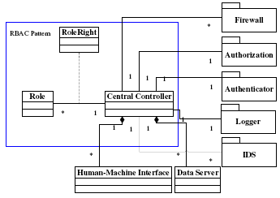
Defenses for the Central Controller

Slide 17
Rest of the system [Fer10]
Similarly we can analyze the network and the field units
For them we find the threats and we apply security patterns to control them
This results in a Secure SCADA pattern

Slide 18
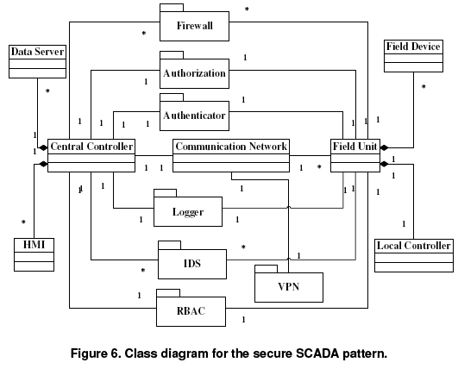

Slide 19
CPS for smart buildings
Physical access control (see next slides): patterns to control access to units
Physical and cyber access control [Pas17]
Extend controls to cyber devices in the
building
Monitoring building health [Bhu17]
No systematic analysis of threats

Slide 20
Physical access control
The need to protect assets in buildings and to control access to restricted areas such as airports, naval ports, government agencies, and nuclear plants, created a great business opportunity for the physical access control industry and a good amount of interest in the research community
One of the results of this interest was the recognition that access control to information and access control to physical locations have many common aspects
The most basic model of access control uses a tuple (s,o,t), subject, object, access type. If we interpret s as a person (instead of an acting executing entity), o as a physical structure (instead of a computational resource), and t as a physical access type (instead of resource access), we can make an analogy where we can apply known results or approaches from information access control
Another issue is the fact that there are standard network protocols for building automation, e.g. BACnet [bac06], which are totally different of the protocols used for manufacturing automation, e.g. DNP3. Both types of protocols define security standards, which means that a building intended for manufacturing would have two sets of incompatible security standards. We need some way to abstract the security requirements of the complete system without regard to specific standard details.

Slide 22
Class diagram for access control to physical structures
The Alarms Monitoring pattern can be integrated so that Zones can control Alarms
Each door has its own Door Relay and the Aux Relays can be used to turn on/off devices. Zones can control Relays.
A TimeSchedule class consists of a few time intervals. A Time Interval consists of a start time, a stop time, and selected day of the week. When the system clock activates a Time Schedule, it can automatically perform some actions. Relays can be turned on and off, alarm zones can be activated or deactivated, and doors can be unlocked
To control access times, roles are combined with Time Schedule to determine both where and when a user can gain access to zones and we also need to be able to assign a Time Schedule for the entire zone that applies to all users.

Slide 23
UC Entering a zone

Slide 24
Consequences
Advantages include:
If all users get proper authorization and such authorizations are enforced at the entrance of restricted units, we can have a secure environment.
We can add special devices to open all room doors in case of emergencies (shelves and compartments would remain closed).
We can easily accommodate visitors and contractors through special roles.
Since access to restricted units is logged, we may audit later the use of the zones and the movement of employees and visitors.
We can generate alarms.
We can turn on/off external devices using relays.
We can configure tasks to happen at a given time of a day in the week.
We can control access to Zones based on time.
We can activate/deactivate roles based on time.
A disadvantage is:
The pattern may be too complex for simple buildings.

Slide 25
Importance of Cargo Ports
U.S. Bureau of Transportation reports that 77% of freight tonnage entering U.S. came by water, compared to 22% by land and 0.3% by air.
U.S. represents only 4.5% of world population but it accounts for 9% of worldwide container traffic.
One container out of eleven engaged in global trade either bound for or originating in the U.S.
Due to its global reach and freight volume, the maritime sector plays a central role in the economic security and stability of our nation.
Any disruption to the maritime transportation system, whether through natural disasters, accidents, failures of infrastructure, or acts of terrorism or cybercrime, can have an immediate and cascading effect throughout the entire supply chain.

Slide 26
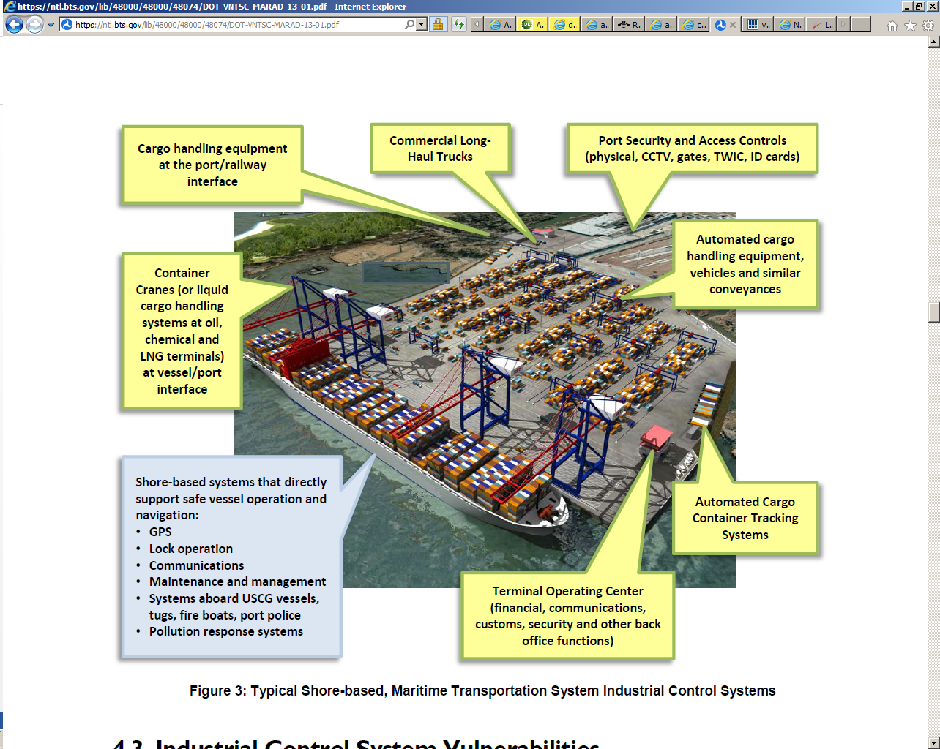
Maritime Container Terminal System
Figure Courtesy of U.S. Department of Transportation - John A Volpe National Transportation Systems Center

Slide 27
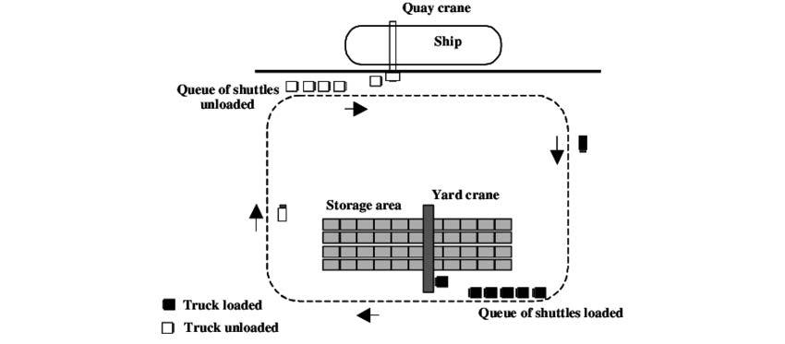
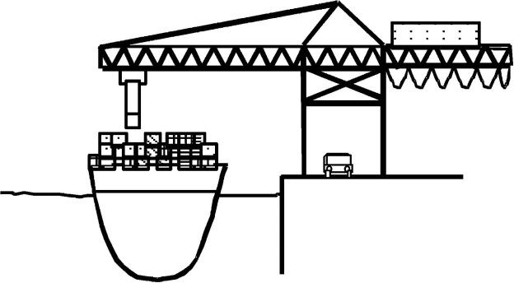
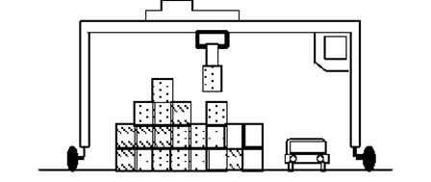
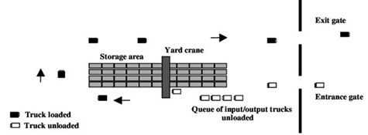
Ship Loading/Unloading Process
Containers unloaded from ship by cranes.
Shuttle trucks take containers to storage.
Shuttle trucks go back to ship to unload
more containers.
Figures Courtesy of www.sciencedirect.com [Bie06]

Slide 28
Maritime Container Terminal System
Transportation
(Trucks, Rail, Ships)
Port Security and Access Control
Cargo Handling Equipment and Storage
(port side)
Terminal Operating Center
Cargo Handling Equipment
(ship side)
Automated Cargo Container Tracking Systems
Port Loading System

Slide 29
Terminal
Quay
TransportMean
*
*
*
Area
Crane
Truck
Train
Ship
*
Buffer
Area
Storage
Area
Quay
Crane
Yard
Crane
Gantry
Crane
Maritime Container Terminal Model
Class Diagram
Export
Area
Import
Area

Slide 30
Cargo port patterns
Ship arrivals and departures—uses a mediator pattern
Port loading facility—describe loading and unloading of containers from ships
Cargo Port Drayage--Provide all the typical functions and security mechanisms for the secure delivery and pick up of containers at a maritime cargo port.
Controlled Access to a Cargo Port Terminal Physical Structure--Describe the mapping of a cargo port functional units to their physical locations and define the allocation of the rights of the individuals or roles associated with these units to access such locations. The allocated rights can be modified dynamically.

Slide 31
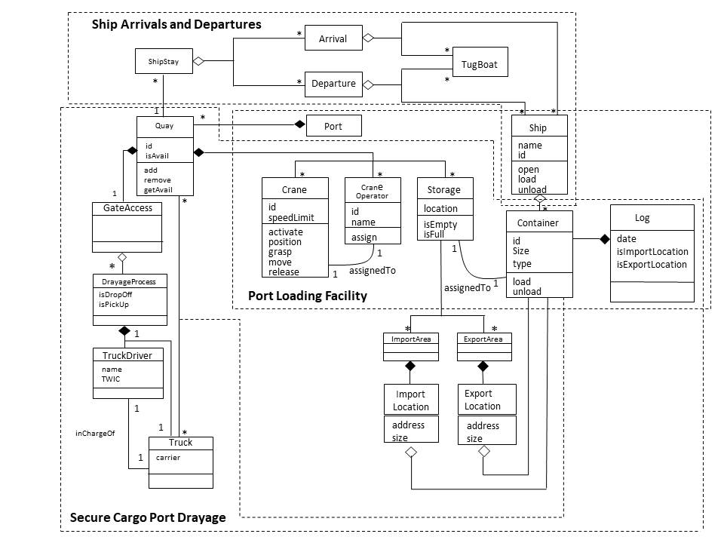
RA for a cargo port [Rom18]

Slide 32
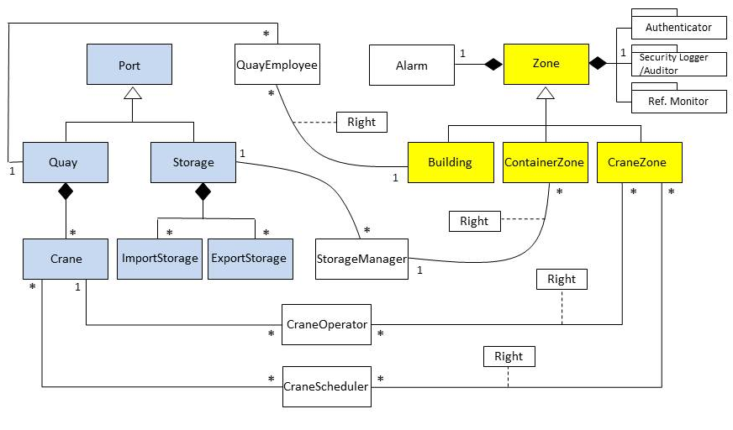
Class Diagram of Cargo Port Terminal Structure

Slide 33
Port structure pattern composition
Combines two patterns: physical access control (seen) and resource assignment
Constrained Resource Assignment Description Pattern. Describes how to perform assignments of resources, e.g. assignment of tools to developers, assignment of patients to hospital rooms, …
Here we assign rights to roles associated with the port functional units (blue) to access physical locations (yellow).
We could have also assigned work locations to each functional unit

Slide 34
The smart grid
The smart grid converts our current electric grid into a large and complex and heterogeneous distributed computing system
This is a cyber-physical system, which is also a virtual organization or a set of these
Parts of the system are wireless and operators will be able to check the status of devices and send them commands from their cell phones
Smart meters measure consumption and transmit readings to the utility servers
This complexity means a great opportunity for security attackers

Slide 35
Smart grid

Slide 36
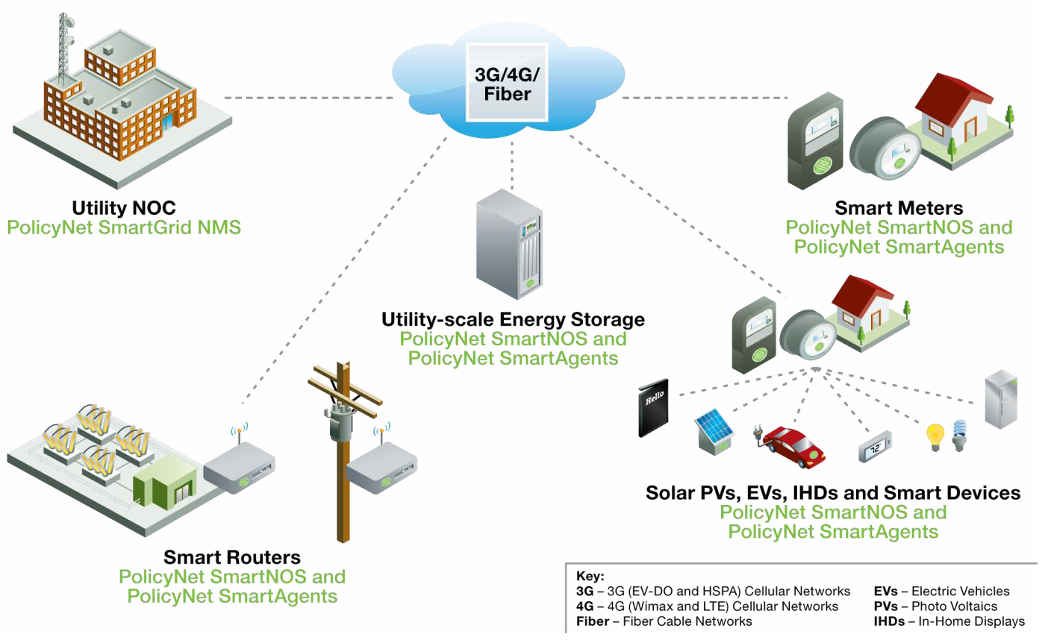

Slide 37
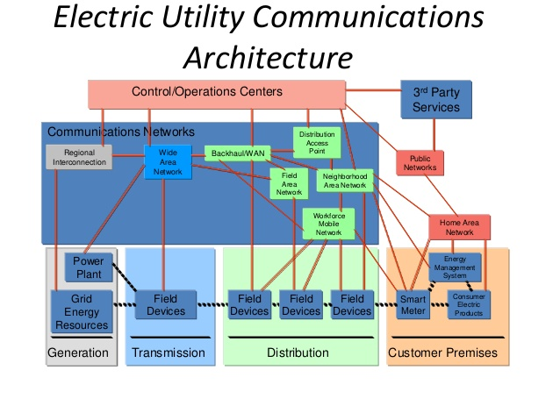

Slide 38
Smart meters [Wikipedia]
A smart meter is an electronic device that records consumption of electric energy and communicates the information to the electricity supplier for monitoring and billing.
Smart meters typically record energy hourly or more frequently, and report at least daily. Smart meters enable two-way communication between the meter and the central system.
Such an advanced metering infrastructure (AMI) differs from automatic meter reading (AMR) in that it enables two-way communication between the meter and the supplier.
Communications from the meter to the network may be wireless, or via fixed wired connections such as power line carrier (PLC).
Wireless communication options in common use include cellular communications (which can be expensive), Wi-Fi (readily available), wireless ad hoc networks over Wi-Fi, wireless mesh networks, low power long range wireless (LORA), ZigBee (low power, low data rate wireless), and Wi-SUN (Smart Utility Networks).

Slide 39
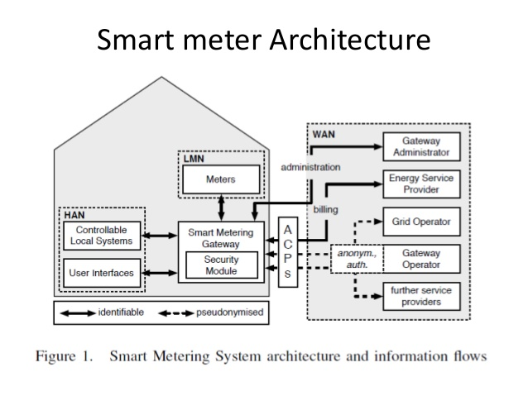

Slide 40
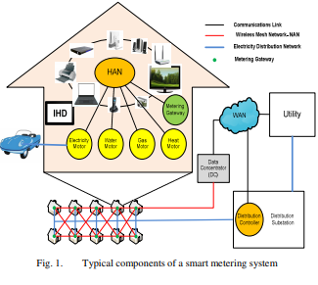
A more general smart meter

Slide 41
Smart meter vulnerabilities
The protocols used by smart meters include ZigBee, which is used for communicating with smart appliances in the consumer’s home, and GSM, which is used for communications between the meter and the electric utility. Both ZigBee and GSM have been known to contain serious vulnerabilities, and they have been poorly implemented in smart meters.
In the case of GSM, many electric utilities still haven’t implemented any form of encryption, despite being warned of the risks several years ago. Those that do use encryption, rely on the A5 algorithm, which is known to be vulnerable to attacks.
Attackers could get smart meters to connect to their own GSM base station by broadcasting a stronger signal than the legitimate base station. The smart meter will connect to the rogue station and will attempt to authenticate using hardcoded credentials, allowing the attacker to hijack traffic and take control of the device.
Moreover, since the meters deployed by each utility use the same credentials, it could be easy for malicious actors to compromise all the devices operated by that organization.
Such attacks can be prevented if utilities use proper encryption, implement network segmentation instead of “using one giant LAN,” and monitor their smart meter networks.

Slide 42
Smart meter vulnerabilities II
In the case of attacks aimed at consumer home networks, hackers can abuse ZigBee, a protocol standardized more than a decade ago. Unlike other devices that use ZigBee, such as smart hubs, smart meters don’t ensure that a new device should be allowed to join the network before they share the network key with it. This key can allow an attacker to impersonate any device and take control of other devices on the network.
If they hijack the meter itself, attackers could find and exploit vulnerabilities – the lack of CPU and memory resources in a smart meter often results in minimized ZigBee code, which does not include security checks. While memory corruption issues, such as buffer overflows, might not be easy to exploit, researchers believe it’s enough for an attacker to find a segmentation fault and crash the meter, which can lead to a power outage.
Debug ports accessible via hardcoded credentials and the lack of proper ZigBee encryption can also be problematic.

Slide 43
Risks (misuses)
A malicious actor who manages to hack a smart meter could obtain information on the targeted user’s power consumption and potentially determine when the victim is at home, or they could inflate the electricity bill. In an incident in Puerto Rico, an electric utility reported hundreds of millions of dollars in losses due to smart meter fraud conducted via hacking and other methods.
Even more worrying is that since smart meters can communicate with all the smart devices in the consumer’s home, an attacker could hijack those systems, including smart door locks.
Some experts also believe that an attacker could cause a meter to explode by making modifications to the software running on the device.

Slide 44
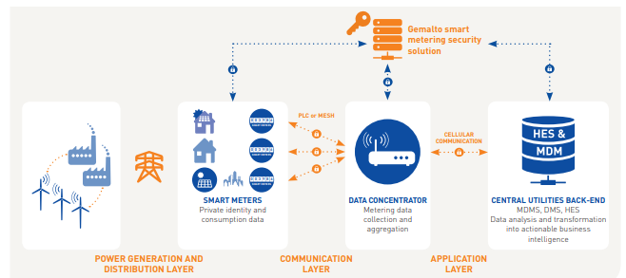
Reinforced meters: a Gemalto product

Slide 45
The weak spot under the hood http://www.nytimes.com/2015/09/27/business/complex-car-software-becomes-the-weak-spot-under-the-hood.html
New high-end cars are among the most sophisticated machines on the planet, containing 100 million or more lines of code.
The sophistication of new cars brings numerous benefits — forward-collision warning systems and automatic emergency braking that keep drivers safer are just two examples. But with new technology comes new risks.
The unfolding scandal at Volkswagen — in which 11 million vehicles were outfitted with software that gave false emissions results — showed how a carmaker could take advantage of complex systems to flout regulations.
it is possible to disable a car’s brakes with an infected MP3 file inserted into a car’s CD player. A hacking demonstration by security researchers exposed how vulnerable new Jeep Cherokees can be.

Slide 46

Security problems in CPSs
For economic and productivity reasons, open networks are an attractive communication medium for CPSs
The increasing use of clouds in CPSs also make their connection to the Internet a necessity
However, doing this increases their vulnerability to intentional attacks (large increase in attack surface)
The objectives of attacks may vary, from terrorist objectives to economic objectives such as collecting private information.

Slide 47
CPS threats
The main threats for CPSs are integrity attacks, illegal modifications or destructions of information, which may result in deception attacks
The attacker wants to disrupt the operations of the physical system or to enable the introduction of physical threats
Another difference is that IT attacks typically target any system and the attacker wants to collect as much information as possible, while CPS attacks target specific types of systems
Attacks in IT systems can take only a few forms while attacks in CPSs have a much larger variety of ways to compromise a system
These differences imply the need for a specialized analysis of threats as well as a corresponding use of security mechanisms and development methodologies to stop them

Slide 48
Threat analysis of CPSs
Threats in robots: only one paper on this topic about the security of robotic operating systems
Analysis of possible threats and then provide corresponding defenses using a secure publish/subscribe framework and cryptography. They analyze the possibility of controlling security at the application level and find the need to complement it with communications security. Not a systematic analysis.
Autonomous vehicles can also be attacked. There are studies of car security but nothing about autonomous vehicles.
For many cases safety has a higher priority than security but safety can be compromised through security attacks

Slide 49
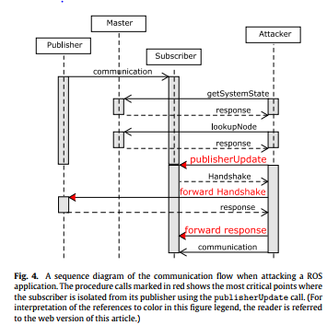
Publish/subscribe attacks in robots

Slide 50
Cross-domain attacks

Slide 51
Some recent attacks
Steel Plant in Germany— destruction of an oven in 2014
Ukraine’s second major power outage in 12 months was the work of cyberattackers. In the most recent incident remote terminal units (RTUs) controlling circuit breakers at Ukrenergo‘s Pivnichna power substation near Kiev suddenly shut down. The resulting power cut lasted an hour, leaving the capital short of a fifth of its power requirements.
Priming suspicion was the striking resemblance of the Pivnichna outage to the now world-infamous cyberattack on three Ukrainian power companies on December 23 2015, which affected 30 sub-stations.
A team of government, industry and academic officials successfully demonstrated that a commercial aircraft could be remotely hacked in a non-laboratory setting last year, a U.S. Department of Homeland Security (DHS) official said Wednesday at the 2017 CyberSat Summit in Tysons Corner, Virginia.

Slide 52
Stuxnet
It is a highly sophisticated worm. Discovered in June 2010, Stuxnet initially spreads via Microsoft Windows, and targets Siemens industrial software and equipment. While it is not the first time that hackers have targeted industrial systems, it is the first discovered malware that spies on and subverts industrial systems, and the first to include a programmable logic controller (PLC) rootkit.

Slide 53
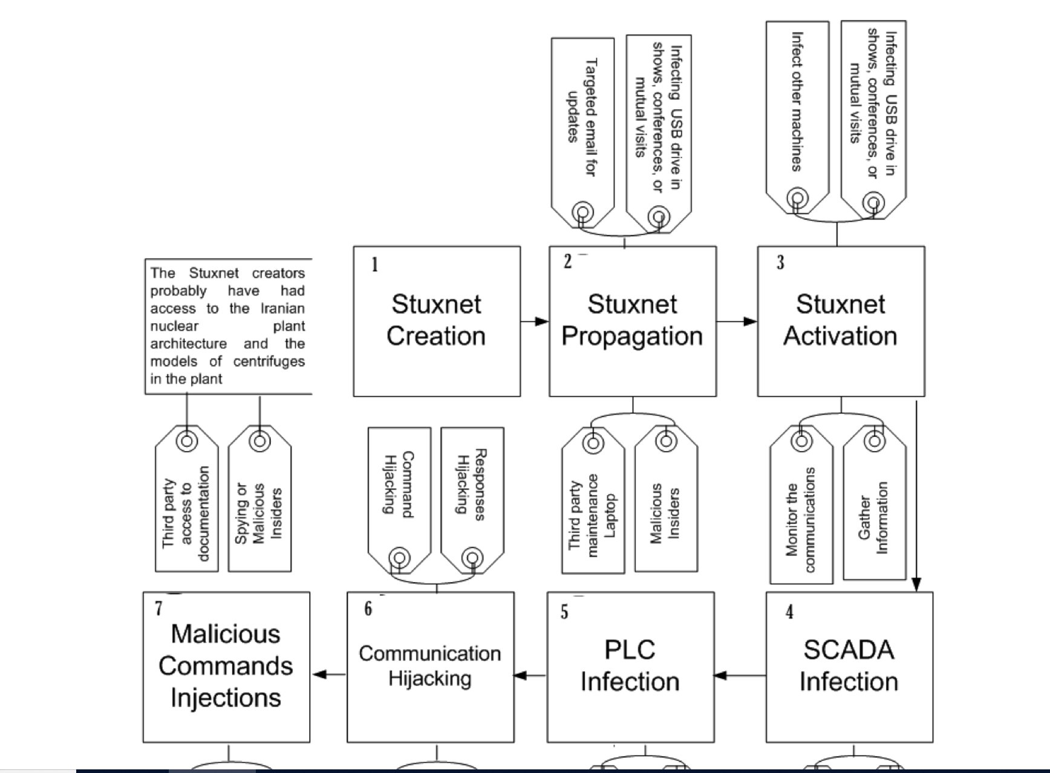
Stuxnet attack process

Slide 54
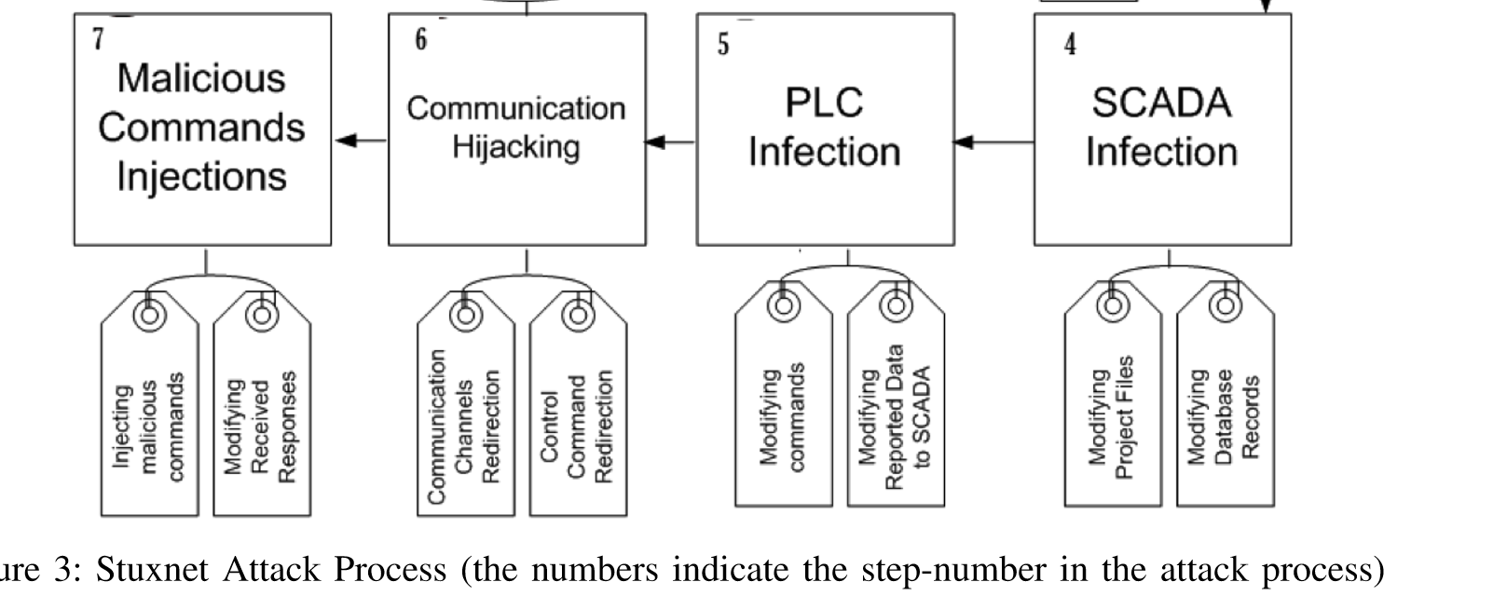

Slide 55
Children of Stuxnet [Wikipedia]
Duqu--On 1 September 2011, a new worm was found, thought to be related to Stuxnet. The Laboratory of Cryptography and System Security (CrySyS) of the Budapest University of Technology and Economics analyzed the malware, naming the threat Duqu. Symantec, based on this report, continued the analysis of the threat, calling it "nearly identical to Stuxnet, but with a completely different purpose", and published a detailed technical paper. The main component used in Duqu is designed to capture info such as keystrokes and system informationn
In May 2012, the new malware "Flame" was found, thought to be related to Stuxnet. Researchers named the program "Flame" after the name of one of its modules. After analysing the code of Flame, Kaspersky said that there is a strong relationship between Flame and Stuxnet. An early version of Stuxnet contained code to propagate infections via USB drives that is nearly identical to a Flame module that exploits the same vulnerability.

Slide 56
Analogies in threats
In CPSs there is an enormous variety of threats, specific to each type of CPS
To help in threat enumeration we intend to show that many of them are similar in effect and can be prevented in similar ways
We use a reference architecture (RA) as a reference framework, i.e., each threat is related to a specific component of the architecture
We are studying cargo ports and smart buildings

Slide 57
Future work for threats in CPSs
Define a new model to represent CPS threats using patterns that are related to architectural aspects of the system and consider cross domain effects.
Extend our threat enumeration system to identify threats in specific systems based on their use cases. Look at cars, drones, robots.
Propose an idea to unify threats that behave in similar ways in different types of CPSs and that can be controlled in similar ways. We look for commonalities in their modus operandi to reduce them to specific types.
Threats in autonomous vehicles have not been studied
Security evaluation of CPSs has not been done. Can we extend the method shown in Chapter 5?

Slide 58
Standards and regulations
IEEE and NIST are creating the “Smart grid interoperability standards roadmap”
There are many regulations being discussed in the US government and in state senates
All US utilities are private companies and it is not clear how enforceable these regulations might be

Slide 59
References
E.B.Fernandez and M.M. Larrondo-Petrie, "Designing secure SCADA systems using security patterns", Procs. of the 43rd Hawaii Conf. on Systems Science, Honolulu, HI, Jan.2010, 1-8. http://ieeexplore.ieee.org/stamp/stamp.jsp?tp=&arnumber=5428672
E.B.Fernandez, J. Ballesteros, A. C. Desouza-Doucet, and M.M. Larrondo-Petrie, “Security Patterns for Physical Access Control Systems”, in S. Barker and G.J. Ahn (Eds.), Data and Applications Security XXI, LNCS 4602, 259-274, Springer 2007. Procs. of the 21st Annual IFIP WG 11.3 Working Conference on Data and Applications Security, Redondo Beach, California, U.S.A, July 8-11, 2007
E.B.Fernandez, “Threat modelling in cyber-physical systems”, IEEE Dependable Autonomic and Secure Computing Conf., Aug. 8-12, 2016, Auckland, New Zealand
V. Romero, E.B.Fernandez, "A Pattern for Secure Cargo Port Drayage," Asian PLoP 2018.
Virginia M. Romero, Eduardo B. Fernandez, “Building a Reference Architecture for Cargo Ports using patterns”, 2018 LACCEI International Multi-Conference of Engineering, Education and Technology.

Slide 60
SCADA References
[Alc12] C. Alcaraz, G. Fernandez, and F. Carvajal, ”Security Aspects of SCADA and DCS Environments”, In Critical Infrastructure Protection: Information Infrastructure Models, Analysis, and Defense, Advances in Critical Infrastructure Protection: Information Infrastructure Models, Analysis, and Defense, LNCS 7130, Springer-Verlag, pp. 120-149, 2012.
[Cru16] T.J.Cruz et al., “Leveraging virtualization technologies to improve SCADA ICS security”, Research Gate 2016
E.B.Fernandez and M.M. Larrondo-Petrie, "Designing secure SCADA systems using security patterns", Procs. of the 43rd Hawaii Conf. on Systems Science, Honolulu, HI, Jan.2010, 1-8. http://ieeexplore.ieee.org/stamp/stamp.jsp?tp=&arnumber=5428672

Slide 61
CPS Sec References I
Bernhard Dieber, Benjamin Breiling, Sebastian Taurer, Severin Kacianka, Stefan Rass, Peter Schartner, “Security for the Robot Operating System”, Robotics and Autonomous Systems 98 (2017) 192–203
[Sab17] Giedre Sabaliauskaite, Geok See Ng, Justin Ruths, Aditya Mathur, “A comprehensive approach, and a case study, for conducting attack detection experiments in Cyber–Physical Systems”, Robotics and Autonomous Systems 98 (2017) 174–191
[Bhu17] Md Zakirul Alam Bhuiyan, Jie Wu, Guojun Wang, Jiannong Cao, Wenjun Jiang, “Towards Cyber-Physical Systems Design for Structural Health Monitoring: Hurdles and Opportunities” ACM Transactions on Cyber-Physical Systems - Special Issue on Smart Homes, Buildings and infrastructures, Volume 1 Issue 4, October 2017

Slide 62
CPS Sec References II
A. Banerjee, K.K. Venkatasubramanian,T. Mukherjee, and S.K.S. Gupta, “Ensuring safety, security, and sustainability of mission-critical cyber-physical systems”, Procs. of the IEEE, vol. 100, No 1, January 2012, 283-299.
A.A. Cardenas, S. Amin, Z.-S. Lin, Y.-L.Huang, C.H.Huang, and S. Sastry, “Attacks against process control systems: Risk assessment, detection, and response”, Procs. of ASSIACS’11, March 22-24, 2011, Hong Kong, China, 355-366.
A.N.Khan, M.L.Mat Kiah, S.U.Khan, and S.A.Madani, “Towards secure mobile computing: A survey”, Future Generation Comp. Systs., 29 (2013), 1278-1299, doi:10.1016/j.future.2012.08.003
M. Satyanarayanan, Grace Lewis, Edwin Morris, Soumya Simanta, and Jeff Boleng, Kiryong Ha, “The role of cloudlets in hostile environments”, IEEE Pervasive Computing, Oct-Dec 2013

Slide 63
References III
Pasqualetti, F., Dörfler, F., & Bullo, F. (2013). Attack detection and identification in cyber-physical systems. IEEE Transactions on Automatic Control, 58(11), 2715-2729.
Dept. of Homeland Security, CPS, https://www.dhs.gov/science-and-technology/csd-cpssec
Khaled Shuaiba, Zouheir Trabelsia , Mohammad Abed-Hafezb , Ahmed Gaoudab , and Mahmoud Alahmadc, “Resiliency of Smart Power Meters to Common Security Attacks”, The 6th International Conference on Ambient Systems, Networks and Technologies (ANT 2015)
https://ioactive.com/pdfs/Commonalities_in_Vehicle_Vulnerabilities_WP.pdf
[Sha] S. Sharma, Smart metering infrastructure Architecture and analytics, https://www.slideshare.net/SandeepSharma65/smart-meter-3
Srđan Vukmirović ; Aleksandar Erdeljan ; Filip Kulić ; Slobodan Luković, “A smart metering architecture as a step towards Smart Grid realization”, 2010 IEEE International Energy Conference

